Slide 1
Tutorial 9 Minimum Spanning Tree
Xinyu Du
Department of Systems Engineering and Engineering Management
Chinese University of Hong Kong

Slide 2
Outline
Minimum Spanning Tree
Kruskal’s Algorithm
Prim’s Algorithm
Tutorial 9

Slide 3
Minimum Spanning Tree
Tutorial 9

Slide 4













Minimum Spanning Tree (MST)
Given an undirected graph $G=(V,E)$ with $n$ nodes. Let $T$ be a set of $n−1$ edges of $G$. If $T$ includes no cycle, it is a spanning tree of $G$.
The cost of $T$ is then the sum of the weights of all edges on $T$
1
$$p_{1}$$
$$p_{1}$$
$$p_{1}$$
5
1
5
1
5
$$p_{2}$$
3
$$p_{4}$$
$$p_{2}$$
$$p_{2}$$
3
$$p_{4}$$
3
$$p_{4}$$
2
2
2
$$p_{3}$$
2
2
2
$$p_{3}$$
$$p_{3}$$
Not a spanning tree, including a cycle
Not a spanning tree
A spanning tree with cost 6

Slide 5








Minimum Spanning Tree (MST)
A minimum spanning tree (MST) is a spanning tree such that the cost is minimum.
1
$$p_{1}$$
$$p_{1}$$
5
1
5
$$p_{2}$$
3
$$p_{4}$$
$$p_{2}$$
3
$$p_{4}$$
2
$$p_{3}$$
2
2
$$p_{3}$$
2
A minimum spanning tree: cost is 5
A spanning tree with cost 6

Slide 6
Kruskal’s Algorithm
Tutorial 9

Slide 7

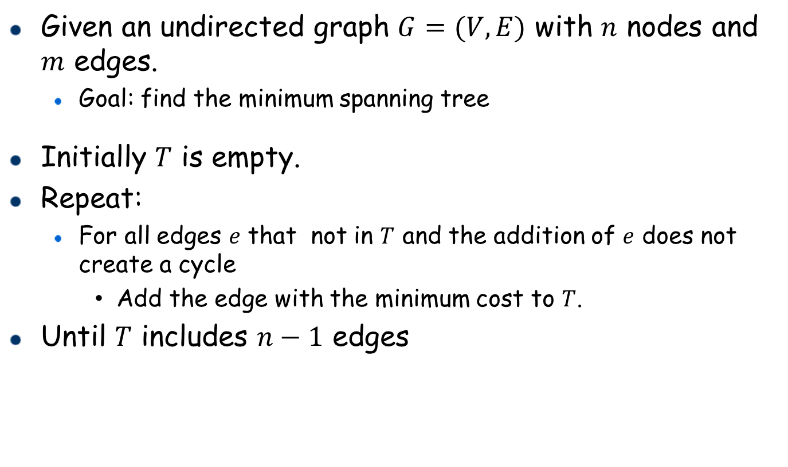



Kruskal’s Algorithm
Given an undirected graph $G=(V,E)$ with $n$ nodes and $m$ edges.
Goal: find the minimum spanning tree
Initially $T$ is empty.
Repeat:
For all edges $e$ that not in $T$ and the addition of $e$ does not create a cycle
Add the edge with the minimum cost to $T$.
Until $T$ includes $n−1$ edges
1
$$p_{1}$$
5
$$p_{2}$$
1
$$p_{4}$$
1.5
$$p_{3}$$
4

Slide 8
















A Running Example: Kruskal’s Algorithm
1
$$p_{1}$$
$$p_{1}$$
5
1
5
$$p_{2}$$
1
$$p_{4}$$
$$p_{2}$$
1
$$p_{4}$$
1.5
1.5
$$p_{3}$$
4
4
$$p_{3}$$
1
$$p_{1}$$
$$p_{1}$$
5
1
5
$$p_{2}$$
1
$$p_{4}$$
$$p_{2}$$
$$p_{4}$$
1
1.5
4
1.5
$$p_{3}$$
$$p_{3}$$
4

Slide 9
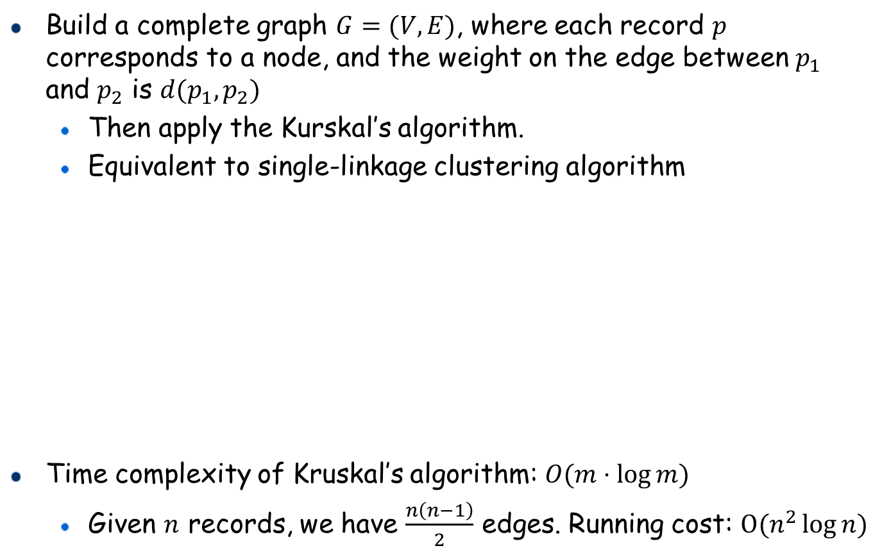
Connection: Single-Linkage Clustering & MST
Build a complete graph $G=(V,E)$, where each record $p$ corresponds to a node, and the weight on the edge between $p_{1}$ and $p_{2}$ is $d(p_{1},p_{2})$
Then apply the Kurskal’s algorithm.
Equivalent to single-linkage clustering algorithm
Time complexity of Kruskal’s algorithm: $O(m⋅\log{m})$
Given $n$ records, we have $\frac{n\left(n−1\right)}{2}$ edges. Running cost: $O(n^{2}\log{n})$
1
$$p_{1}$$
What does it indicate if an edge causes a cycle?
5
They belong to the same cluster.
$$p_{2}$$
1
$$p_{4}$$
Which edge will be picked if we run the single-linkage clustering algorithm?
1.5
4
$$p_{3}$$
The edge with minimum cost among all edges that the two nodes on the edge are not in the same cluster

Slide 10











Single-Linkage Clustering & MST
Given 5 records $p_{1}=1,p_{2}=2,p_{3}=4,p_{4}=5,p_{5}=10$.
Show how to apply the Kruskal’s algorithm to do single-linkage clustering
1
$$p_{1}$$
9
1
$$p_{1}$$
4
9
3
8
3
4
$$p_{2}$$
$$p_{5}$$
8
$$p_{2}$$
$$p_{5}$$
6
2
5
6
3
2
5
$$p_{3}$$
$$p_{4}$$
3
1
$$p_{3}$$
$$p_{4}$$
1
Create a graph where each node corresponds to a record, and each edge is a record pair with weight equal to their distance
Include a new edge with minimum cost but does not cause a cycle

Slide 11





















Single-Linkage Clustering & MST
Given 5 records $p_{1}=1,p_{2}=2,p_{3}=4,p_{4}=5,p_{5}=10$.
Apply the Kruskal’s algorithm to do single-linkage clustering
1
$$p_{1}$$
$$p_{1}$$
9
1
9
3
4
4
8
3
8
$$p_{2}$$
$$p_{5}$$
$$p_{2}$$
$$p_{5}$$
6
6
2
5
5
3
2
$$p_{3}$$
$$p_{4}$$
3
What is the corresponding dendrogram?
1
$$p_{3}$$
$$p_{4}$$
1
$$p_{1}$$
$$p_{1}$$
1
9
1
9
3
4
3
4
8
8
$$p_{2}$$
$$p_{5}$$
$$p_{2}$$
$$p_{5}$$
6
6
2
5
2
5
3
3
$$p_{3}$$
$$p_{4}$$
$$p_{3}$$
$$p_{4}$$
1
1

Slide 12
Prim’s Algorithm
Tutorial 9

Slide 13
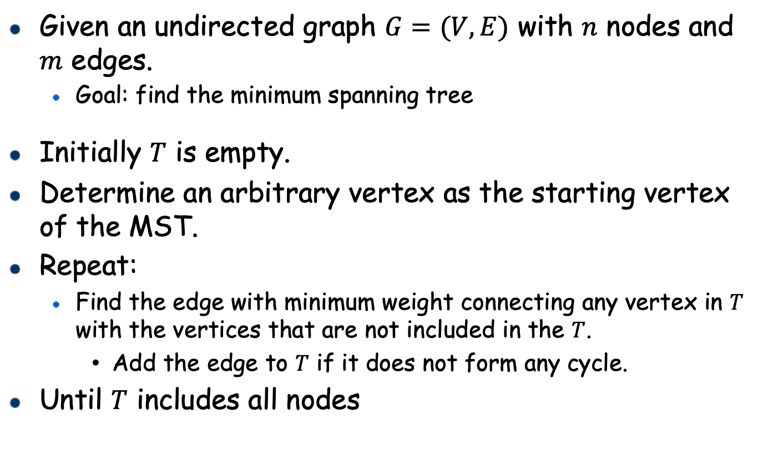
Prim’s Algorithm
Given an undirected graph $G=(V,E)$ with $n$ nodes and $m$ edges.
Goal: find the minimum spanning tree
Initially $T$ is empty.
Determine an arbitrary vertex as the starting vertex of the MST.
Repeat:
Find the edge with minimum weight connecting any vertex in $T$ with the vertices that are not included in the $T$.
Add the edge to $T$ if it does not form any cycle.
Until $T$ includes all nodes

Slide 14
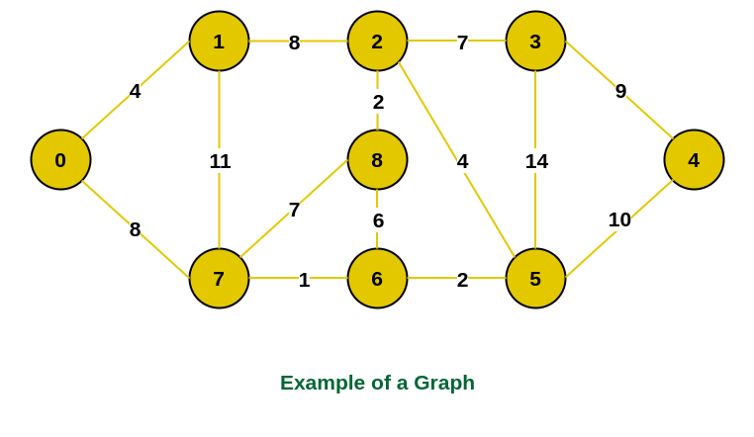
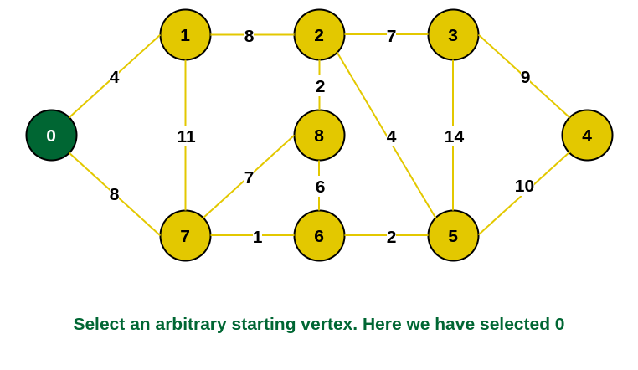
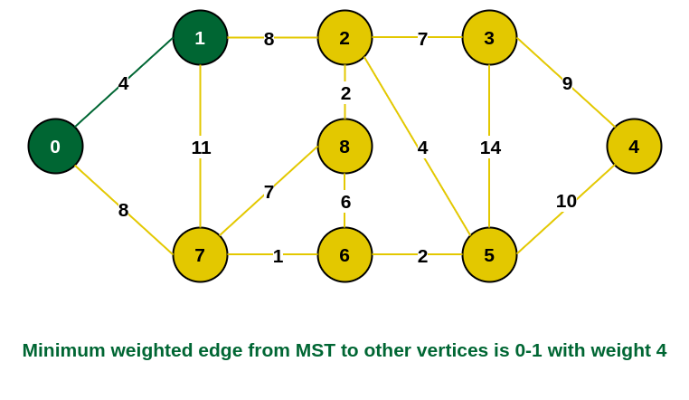
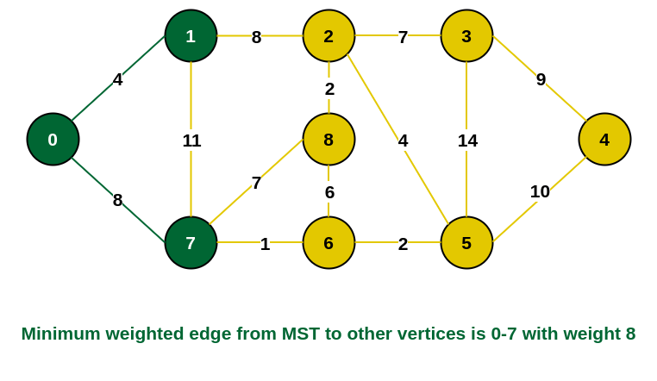
A Running Example: Prim’s Algorithm

Slide 15
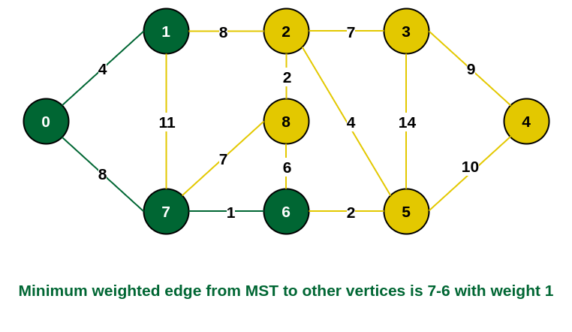
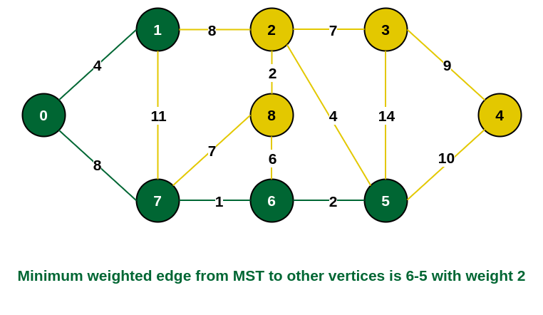
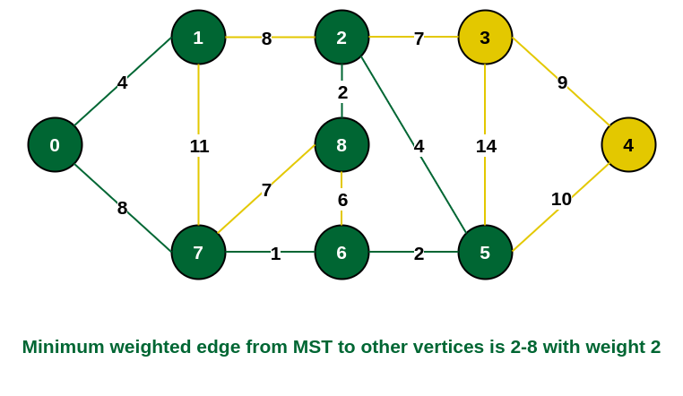
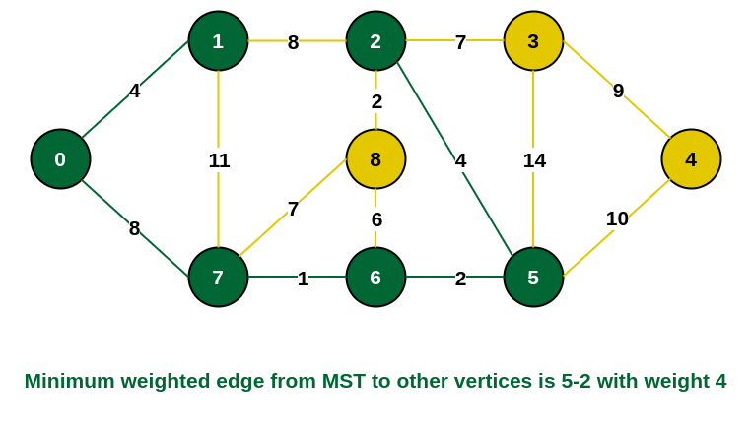
A Running Example: Prim’s Algorithm

Slide 16
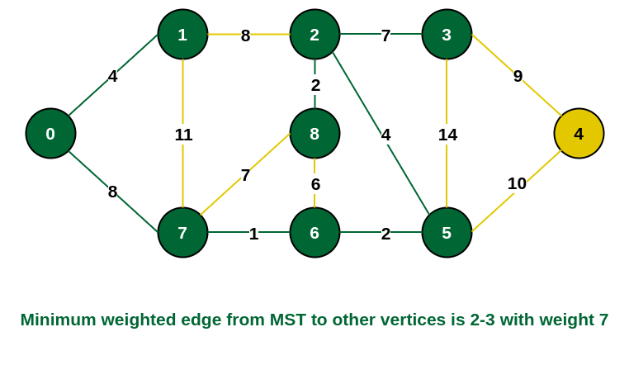
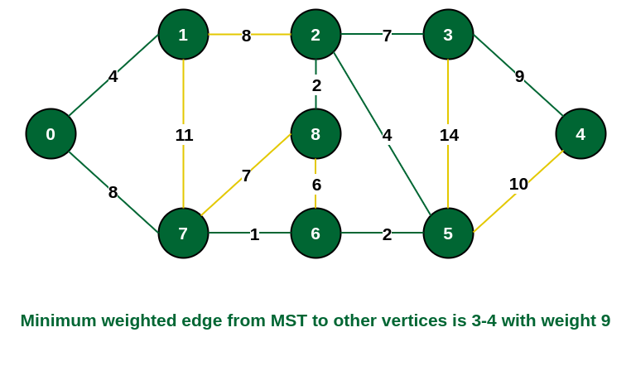
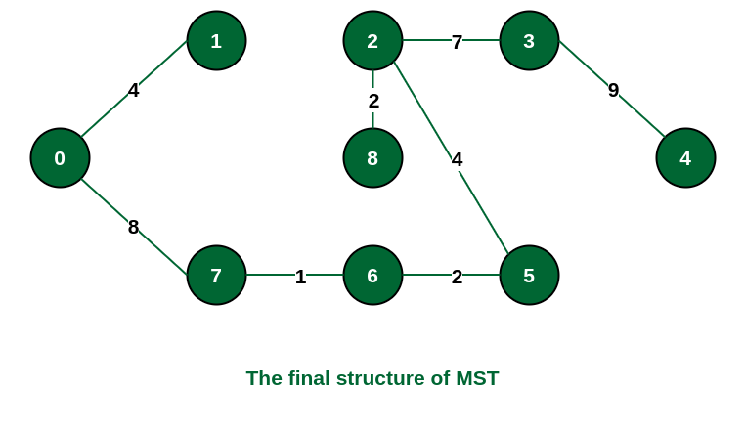
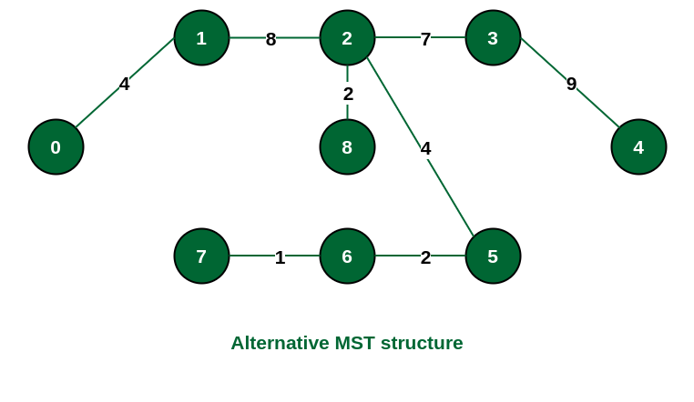
A Running Example: Prim’s Algorithm

